Slide 1
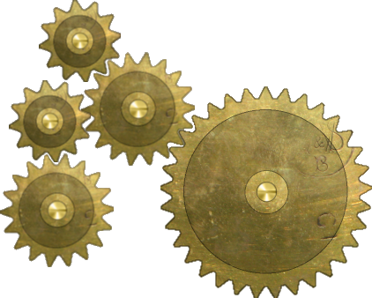
The Gear Class Constructor Create Gear Joints
CreateGearJoint(0, 1, 18.0f/33.0f);
CreateGearJoint(1, 2, 12.0f/18.0f);
CreateGearJoint(1, 3, 12.0f/18.0f);
CreateGearJoint(3, 4, 18.0f/12.0f);
CreateGearJoint(0, 5, 18.0f/33.0f);
CreateGearJoint(5, 6, 1.0f);
CreateGearJoint(5, 7, 1.0f);
CreateGearJoint(7, 8, 1.0f);
} //constructor
2
1
3
0
4
0
1
2
3
4
11
12
1
2
10
3
9
8
4
7
6
5

Slide 2
